Slide 1
Minor Project Code: 15ECSW302 Sem: VI Year: 2020-21
Project Title: Integer Factorization using Shor’s Algorithm
Team Number: S3
Team Members:-
Guide Name: Mr. KMM Rajashekaraiah
NAME | USN
Raj Jain | 01FE18BCS002
Aayush Rajwade | 01FE18BCS005
Aman Kumar | 01FE18BCS029
Ayush Utsav | 01FE18BCS059

Slide 2
Project Overview / Summary
Domain/Problem Space :
Number Theory
Quantum Computing
Applications:
Breaking public key RSA Cryptography.
Enabling Quantum Cryptography.
Problem Definition :
To do Integer Factorisation by using Shor’s Quantum Algorithm.

Slide 3
Comments from Review 1
Define your contribution precisely and increase novelty .
Check with bench algorithms .
Quantify the improvements :Reduce iterations
Quote complexity from literature .

Slide 4
Responses
Use of sequential quantum fourier tranformation rather than normal quantum fourier tranformation .
The Quantum Information Project Course at TU Delft achieved 60% probability success for correct factor prediction .
By using SQFT we aim to reduce the number of iterations while maintaining the probability success rate .
Shors Quantum Algorithm runs in O(n³ logn) time and uses O(n² logn log logn) gates .

Slide 5
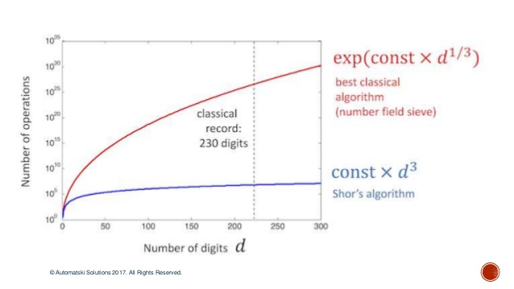
Goals/Objectives:
To do integer factorisation using Shor’s Quantum Algorithm .
To do factoring of integers with maximum possible probability .
To reduce the number of iterations .

Slide 6
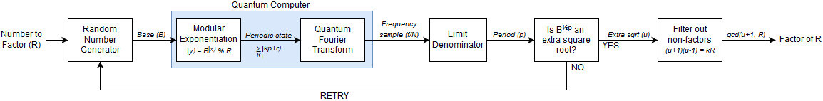
Proposed system / Solution
The proposed solution involves two major steps:-
Period Finding
Sequential Quantum Fourier Transform

Slide 7
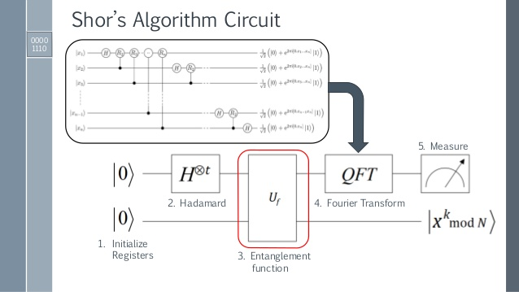
Component level design

Slide 8
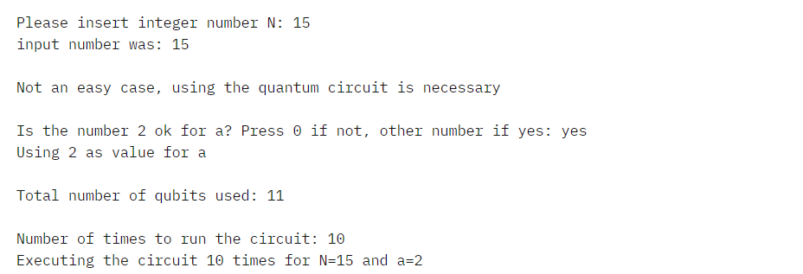
Modules Completed
Implementation of normal QFT with 30 % probability success rate .
Screenshots of output

Slide 9
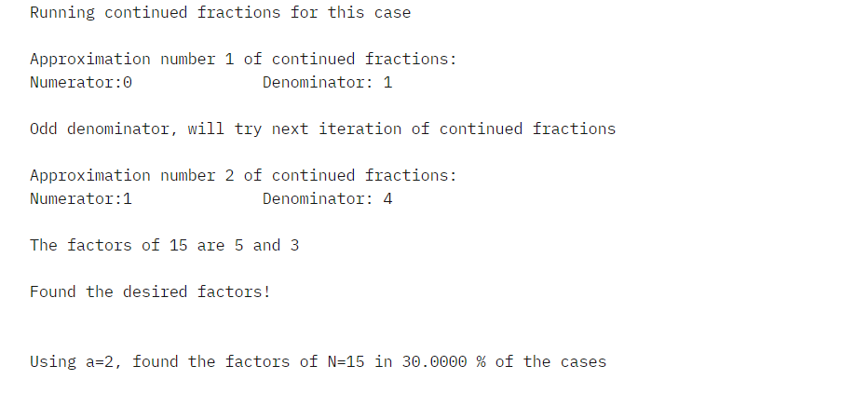

Slide 10
Modules to be Completed
Using normal QFT we achieved the probability success rate of 30% .
To increase the probabilty success rate upto atleast 60% using Sequential Quantum Tranform (to be completed ).

Slide 11
References
Abhijith, J., et al. "Quantum algorithm implementations for beginners." arXiv e-prints (2018): arXiv-1804.
Speiser, Jacqueline. "Implementing and Comparing Integer Factorization Algorithms.“
Steiger, Damian S., Thomas Häner, and Matthias Troyer. "ProjectQ: an open source software framework for quantum computing." Quantum 2 (2018): 49.

Slide 12
Thank You!!

